Slide 1

FITT Principle
What is the FITT Principle?

Slide 2
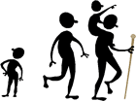
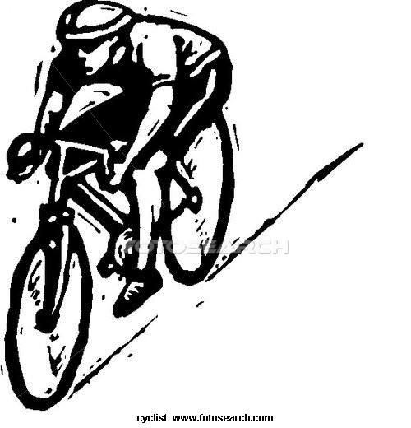
The FITT Principle is a set of guidelines created to help people benefit from exercise.

Slide 3
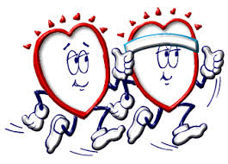
FITT Principle is an Acronym.
Here is the breakdown:
F: Frequency (How OFTEN do I need to exercise?)
I: Intensity (How HARD do I need to exercise?)
T: Time (How LONG do I need to exercise?)
T: Type (What KIND of exercise do I need to do?)

Slide 4
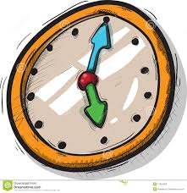

Frequency:
60 Minutes Every Day

Slide 5

Intensity:
You want to be at your Target Heart Rate when you exercise.
-What is your Resting Heart Rate?
-What is your Maximum Heart Rate?
-What is your Target Heart Rate?

Slide 6
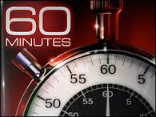
Time:
60 Minutes per session

Slide 7

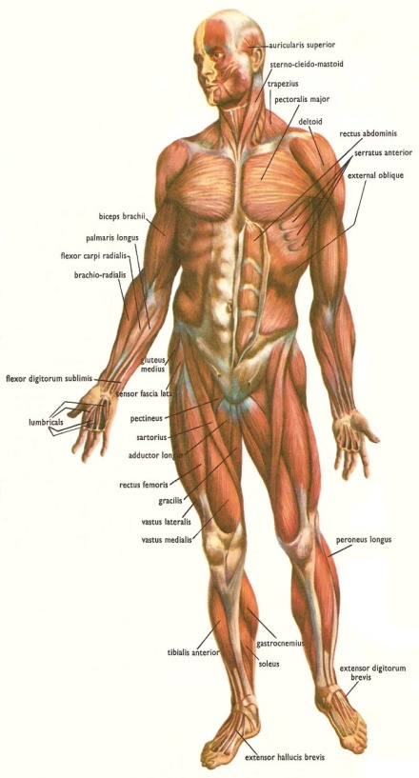
Types:
Two Main categories of Exercises are Aerobic and Anaerobic
Aerobic Exercises = The HEART
-Uses Oxygen to meet energy demands
Anaerobic Exercises = The Skeletal Muscles
-Promotes strength, speed, and power within the muscles

Slide 8
Anaerobic Exercises can be broken down into THREE main categories:
Isometric
2. Isotonic
3. Isokinetic

Slide 9
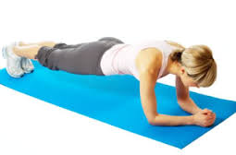
Isometric
-Holding a Muscle Contraction
-Muscles are NOT moving once they are in position
Ex: Planks
Wall Sits

Slide 10
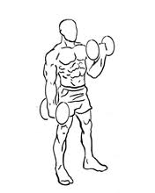
Isotonic
-Muscles ARE moving
-Exercises can include free weights or your body’s own resistance
Ex: Sit-ups, Bicep curls, Pull Ups, Chest Press, Leg Lifts

Slide 11
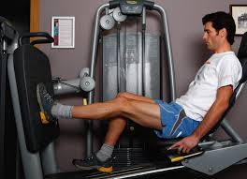
Isokinetic
-Using machines to strength train the muscles
-Can isolate some muscles and only work the principle of specificity
-Best for beginners, the elderly, or athletes that have particular positions on a sports team

